Slide 1
Data Warehouse, Data Mart & Data Data Lakes
C9-Week-1
Define a data warehouse.
List the benefits of and use cases for data warehouses.
Describe the three most popular data warehouse platforms.
Discuss the five mission-critical criteria to evaluate before implementing a new data warehouse system.
List the various types of data warehouse costs.
Define a data mart, describe how to populate data marts, relate data mart examples, and compare data marts to transactional databases and enterprise data warehouses.
Describe a data lake, identify the benefits of data lakes, and recap the differences between data lakes and data warehouses.
Create a Db2 instance on IBM Cloud.
Locate and explore the Db2 console on IBM Cloud.
Create credentials for accessing a Db2 instance on IBM Cloud.

Slide 2
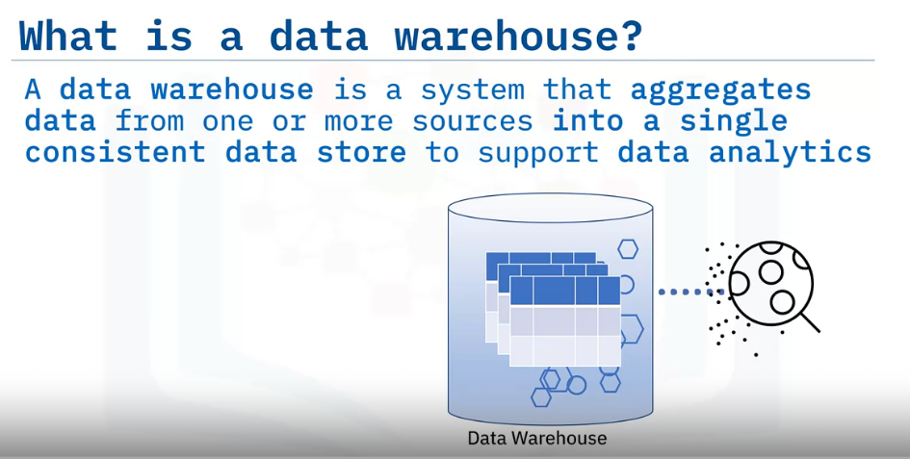
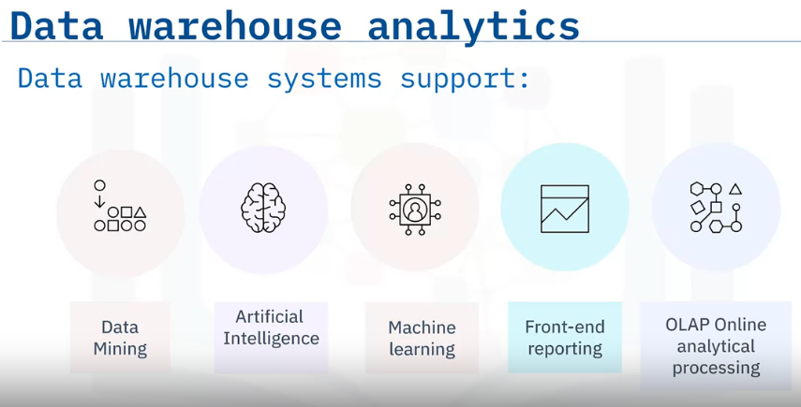
Data Warehouse Overview
Data warehouse systems support data mining, including the application of artificial intelligence and machine learning.
Data transformation during the ETL process speeds front-end reporting, delivering critical information fast.
Data warehouses enable online analytical processing, known as OLAP, which provides fast, flexible, multidimensional data analysis for business intelligence and decision support applications.

Slide 3
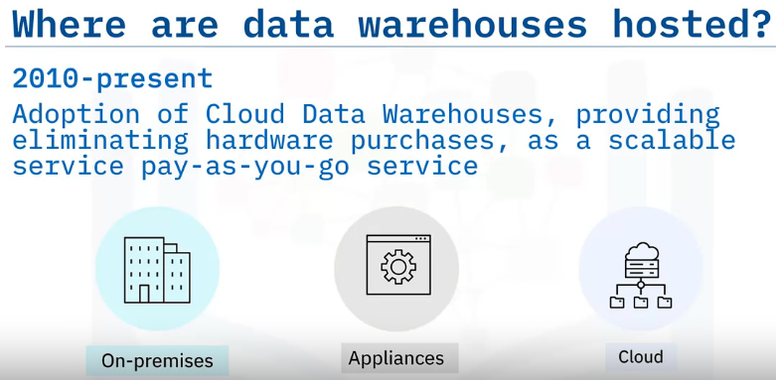
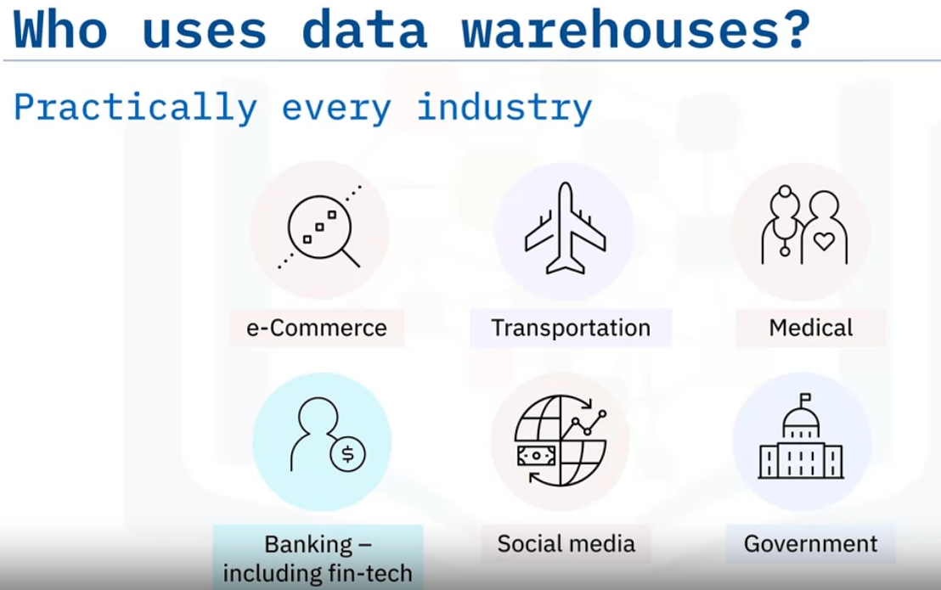
Traditionally, data warehouses have been hosted on-premises within enterprise data centers, initially on mainframes and then on Unix, Windows, and Linux systems.
Data warehouse appliances emerged with the growth of more extensive data volumes in the 2000s.
These appliances consisted of a pre-integrated bundle of specialized hardware and optimized data warehousing software that reduced large-scale data warehousing management overhead.
In the last decade or so, with exponential amounts of data being generated and stored in the cloud, Cloud Data Warehouses, frequently called CDWs, have gained popularity, where organizations don't purchase hardware or install warehousing software.
Instead, organizations access data warehouses as a scalable, pay-as-you-go service.
Retail and e-commerce organizations use data warehouses to analyze and report on sales performance. These organizations also apply machine learning assisted shopping that provides shoppers with relevant recommendations that drive additional sales.
By applying artificial intelligence to patient data, healthcare providers can access the most recent insights and use that information to diagnose and treat their patients with greater accuracy.
BI capabilities enable transportation providers to optimize routes, travel times, equipment needs, and staffing requirements.
Financial tech organizations, including banking, apply data analytics to evaluate risks, detect fraud, and cross-sell services.
Social media organizations need analytic capabilities that can quickly measure ever-changing customer sentiment and project product sales.
Governments apply business intelligence to analyze and evaluate citizen-focused programs and assist with policy change decisions.

Slide 4
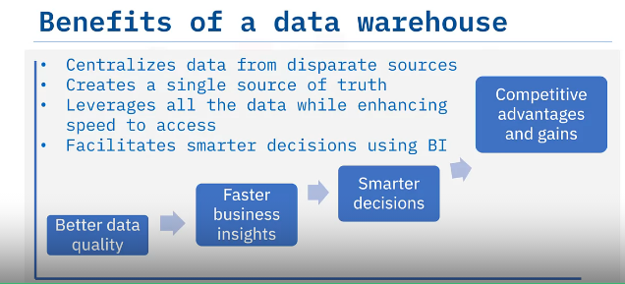
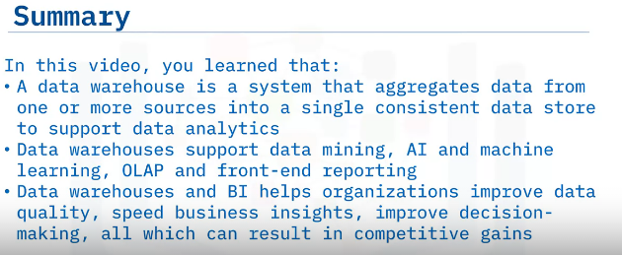
Data warehouses enable organizations to centralize data from disparate data sources, such as transactional systems, operational databases, and flat files.
Data integration, removing bad data, eliminating duplicates, and standardizing data create a single source of the truth that results in better data quality for analysis.
A single source of truth empowers users to leverage all the company's data and access that data more efficiently.
In addition, separating database operations from data analytics generally improves data access performance, leading to faster business insights.
Next, large-scale BI functions such as data mining, artificial intelligence, and machine learning tools facilitate smarter decisions by data professionals and business leaders.
These capabilities build on each other to give organizations the means and opportunity to realize competitive advantages and gains.

Slide 5
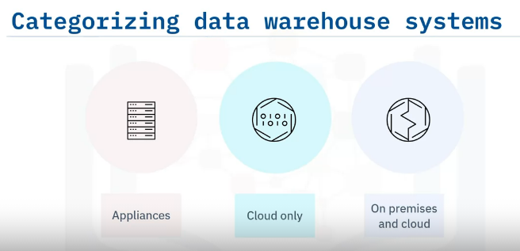
Popular Data Warehouse Systems
Most data warehouse systems are supported via one or more of three platforms.
First are appliances, which are pre-integrated bundles of hardware and software that provide high performance for workloads and low maintenance overhead.
Other vendors support cloud deployments only, offering the benefits of cloud scalability and pay-per-use economics, and in many cases, deliver their data warehouses as fully managed services.
Some warehouse offerings have traditionally been available as software installed only within on-premises environments, but in recent years, most of these vendors now offer cloud-deployed data warehouse systems.

Slide 6
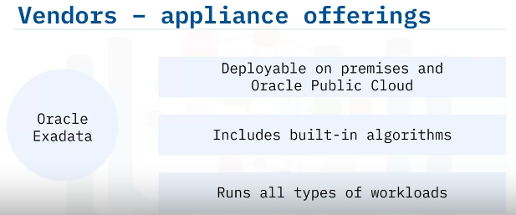
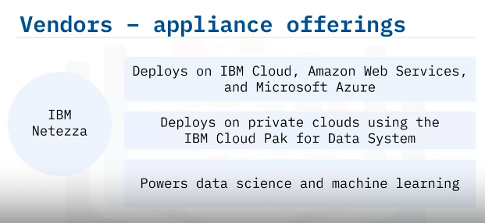
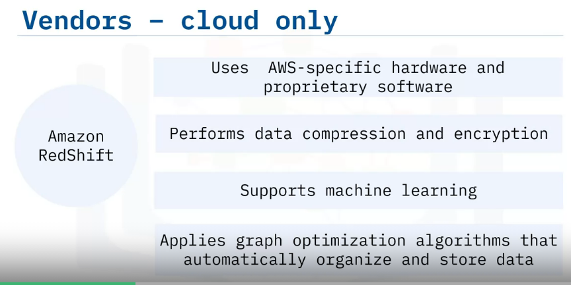
Oracle Exadata.
An organization can deploy this data warehouse solution as part of an on-premises installation or via Oracle Public Cloud.
Oracle Exadata features built-in algorithms and runs all types of workloads, including OLTP, data warehouse analytics, in-memory analytics, and mixed workloads.
IBM Netezza is another warehousing appliance. ​
You can deploy IBM Netezza on IBM Cloud, Amazon Web Services, Microsoft Azure,​ and private clouds using the IBM Cloud Pak for Data System. ​
IBM Netezza is widely recognized for its data science and machine-learning enablement.​
Amazon RedShift uses Amazon Web Services-specific hardware and proprietary software in the cloud for accelerated data compression and encryption, machine learning, and graph-optimization algorithms that automatically organize and store data.

Slide 7
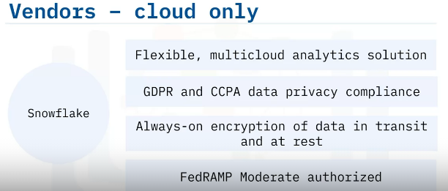
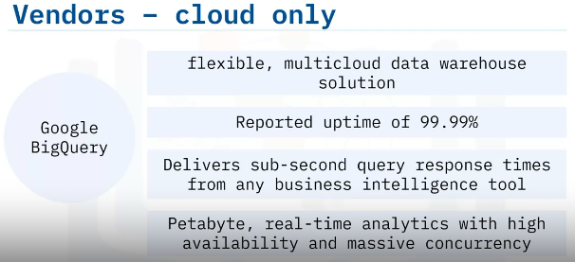
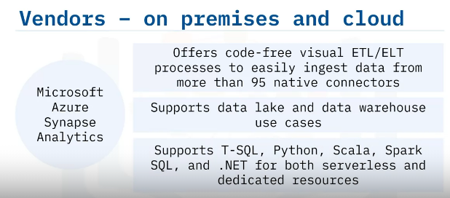
Up-and-coming Snowflake offers a multi-cloud analytics solution that complies with GDPR and CCPA data privacy regulations.
Snowflake advertises its always-on encryption of data in transit and at rest.
Snowflake is FedRAMP Moderate authorized.
Google BigQuery describes its data warehouse system as a "flexible, multi-cloud data warehouse solution."
Google reports data warehouse uptime of 99.99% and delivery of sub-second query response times from any business intelligence tool.
Google BigQuery's system specifies petabyte speed and massive concurrency to deliver real-time analytics.
Microsoft Azure Synapse Analytics offers code-free visual ETL/ELT processes to ingest data from more than 95 native connectors.
Azure Synapse Analytics supports data lake and data warehouse use cases and supports the use of T-SQL, Python, Scala, Spark SQL, and dot Net for both serverless and dedicated resources.

Slide 8
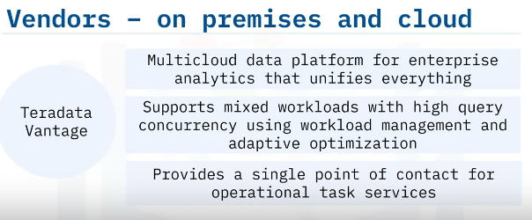
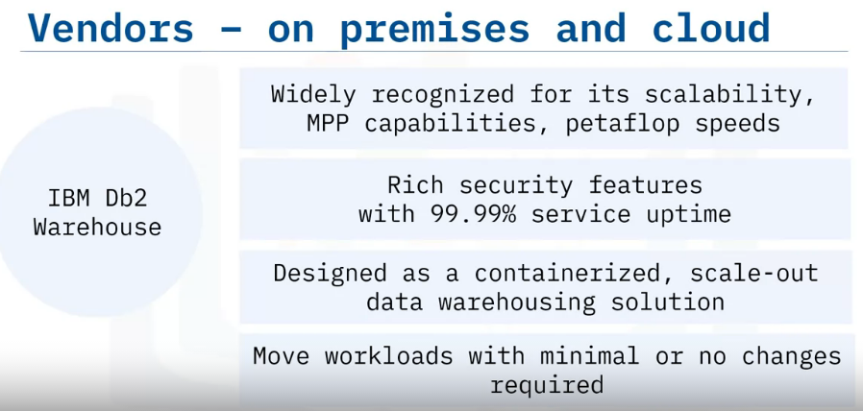
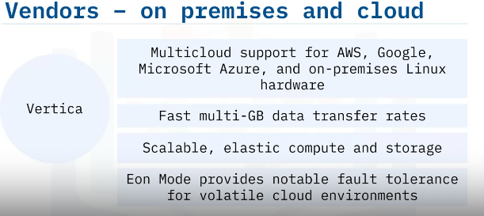
Teradata Vantage advertises its multi-cloud data platform for enterprise analytics that unifies data lakes, data warehouses, analytics, and new data sources and types.
Teradata Vantage combines open source and commercial technologies to operationalize insights and delivers performance for mixed workloads with high query concurrency using workload management and adaptive optimization.
For support, Teradata provides a single point of contact for operational task services including monitoring, change requests, performance tuning, security management, and reporting
IBM Db2 Warehouse is widely recognized for its scalability, massively parallel processing capabilities, petaflop speeds, security features, and 99.99% service uptime.
IBM Db2 Warehouse provides a containerized scale-out data warehousing solution.
You can move workloads where needed, including the public cloud, private cloud, or on-premises--with minimal or no changes required.
Vertica, another known hybrid-cloud data warehouse system, provides multi-cloud support for Amazon Web Services, Google, Microsoft Azure, and on-premises Linux hardware.
Vertica reports fast multi-GB data transfer rates, scalable, elastic compute and storage, and notable system fault tolerance when using Eon mode

Slide 9
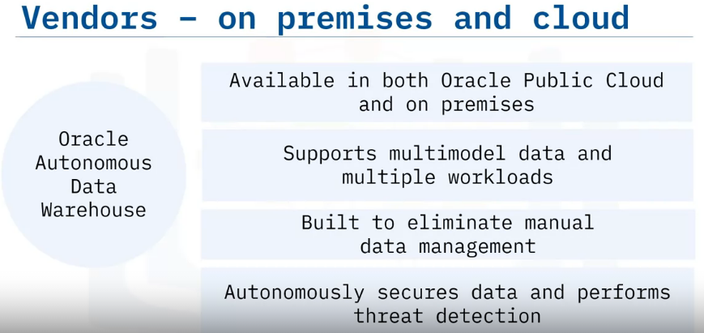
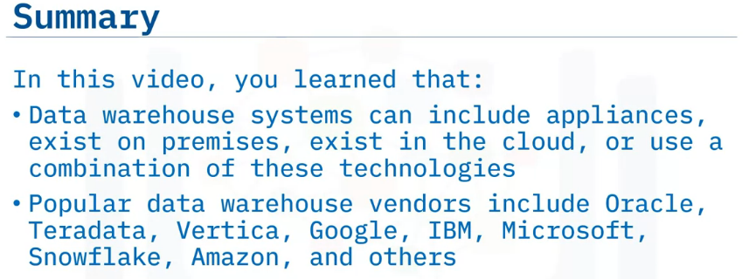
Oracle Autonomous Data Warehouse runs in Oracle Public Cloud and on-premises with support for multi-model data and multiple workloads.
Oracle describes its system as built to eliminate manual data management and reports that they provide extensive automated security features, including autonomous data encryption both at rest and in motion, protection of regulated data, security patch application, and threat detection.

Slide 10
Selecting a Data Warehouse System
Identify criteria organizations can use to evaluate data warehouse systems;
Describe key considerations for each data warehouse selection criteria;
Summarize how organizations decide between an on-premises or a public cloud data warehouse system;
List the various types of warehouse costs.

Slide 11
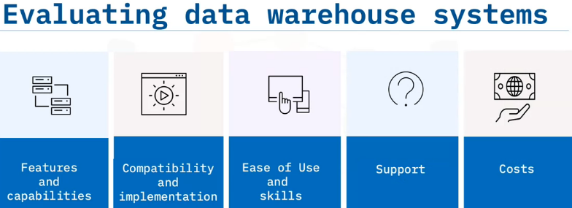
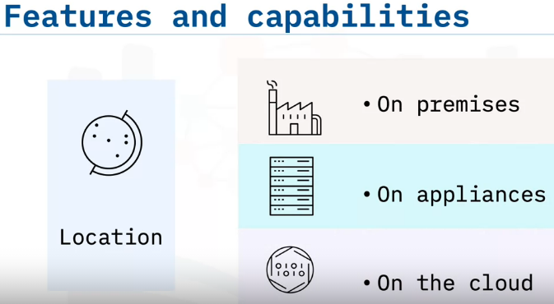
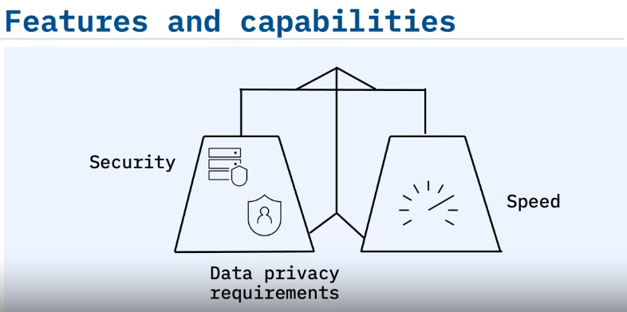
Let’s look at the criteria businesses use to evaluate data warehouse systems, including features and capabilities, compatibility and implementation considerations, ease of use and skills, support considerations, and various costs.
One of the primary data warehouse features, or consideration, for an organization is location.
Data warehouses can exist on-premises, on appliances, and on one or more cloud locations.
To select a location, organizations must balance multiple demands related to data ingestion, storage, and access.
For some organizations, securing their data is their highest priority, requiring a mandatory on-premises solution.
Multi-location businesses that grapple with data privacy requirements such as CCPA or GDPR need on-premises or geo-specific data warehouse locations.
Every organization balances security and data privacy requirements with the need for speed that delivers critical, profit-producing business insights.

Slide 12
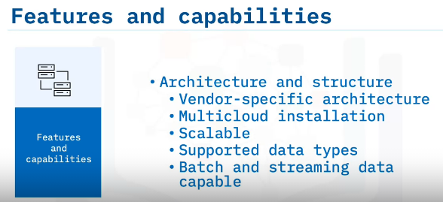
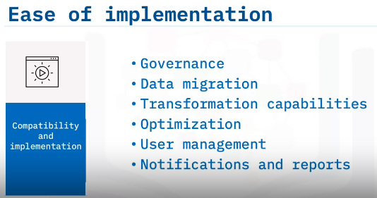
Organizations will also want to consider features and capabilities related to architecture and structure.
Is the organization ready to commit to a vendor-specific architecture?
Does the organization need multi-cloud installation such as multiple data warehouses in multiple locations?
Does the solution scale to meet anticipated future needs?
What data types are supported and what types of data does the organization ingest?
If your organization currently analyzes dark data or is planning for the implementation of using semi-structured and unstructured data, you’ll want a data warehouse system that supports these data types.
And an organization that processes big data needs a system that supports both batch and streaming data.
Capabilities that affect the ease of implementation include data governance, data migration, and data transformation capabilities.
With the data warehouse system in place, how easily can the organization optimize and reoptimize system performance as needs change?
Another consideration is user management. With more organizations implementing a zero-trust security policy because of expensive data breaches, implementing programs that manage and validate system users is mandatory.
And notifications and reports are essential for organizations to correct errors and mitigate risks before minor issues become larger problems

Slide 13
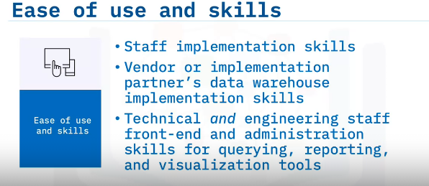
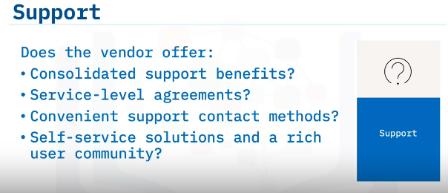
ease of use and skills.
Does your organization’s staff have the skills needed to implement a specific data warehousing vendor’s technology, and if not, how quickly and easily can they gain those skills?
Complex, large data warehouse deployments can require additional work from your implementation partner, so their expertise also greatly matters.
Finally, do the technology and engineering staff who architect, deploy, and administer front-end querying, reporting, and visualization tools have the skills needed to configure your new system quickly?
Support is essential and can become frustrating and expensive if not well planned for.
You might find that by using a single vendor, you can leverage one highly accountable, responsible source, potentially saving you time, money, and frustration.
You’ll also want to verify the availability of service level agreements for uptime, security, scalability, and other data warehouse system issues.
Validate the vendor’s support hours and channels, such as by phone, email, chat, or text.
Finally, does the vendor offer self-service solutions and an active rich user community?

Slide 14
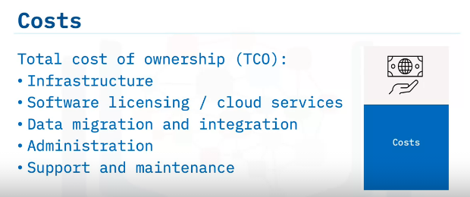
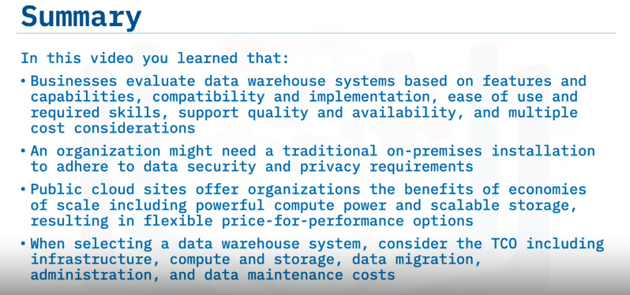
After all this analysis, it’s time to evaluate and compare costs.
When calculating costs for a data warehouse system, consider more than the initial costs.
Consider the total cost of ownership, or TCO, for running systems for several years.
TCO includes:
Infrastructure such as compute and storage costs – whether on-premises or on cloud;
Software licensing, or in case of cloud offerings, their subscription or usage costs;
Data migration and integration costs for moving data into the warehouse and pruning and purging as required;
Administration costs for personnel to manage the systems and to train them; and
Recurring support and maintenance costs paid to the warehousing vendor or implementation
partner

Slide 15
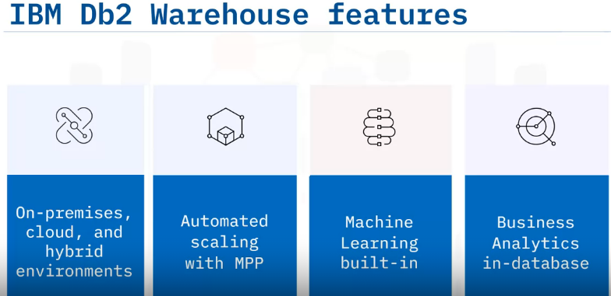
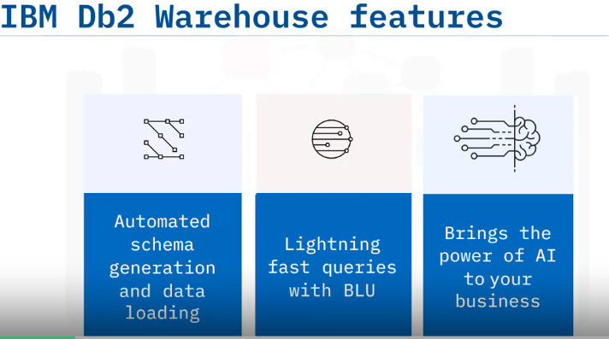
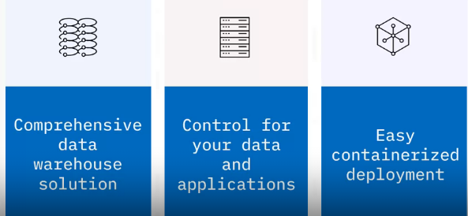
IBM DB2 Warehouse
IBM Db2 Warehouse is a complete data warehouse solution that offers a high level of control over your data and applications.
Db2 Warehouse is easy to deploy within containerized environments such as Docker.
Db2 Warehouse is a highly flexible data warehouse for client-managed, on-premises, cloud, and hybrid environments, that scales automatically with Massively Parallel Processing, known as MPP, to support containerized deployments.
Db2 Warehouse comes pre-packaged with access to machine learning algorithms and utilizes in-database business analytics for speed.
Db2 Warehouse enables you to automatically generate data schemas, and seamlessly transform and load unstructured data sources into a structured format for analysis.
Db2 Warehouse speeds queries using BLU Acceleration, which includes in-memory SQL columnar processing, data-skipping; and, as mentioned before, a Massively Parallel Processor cluster architecture that speeds complex queries.
Db2 Warehouse supports your AI analytics needs

Slide 16
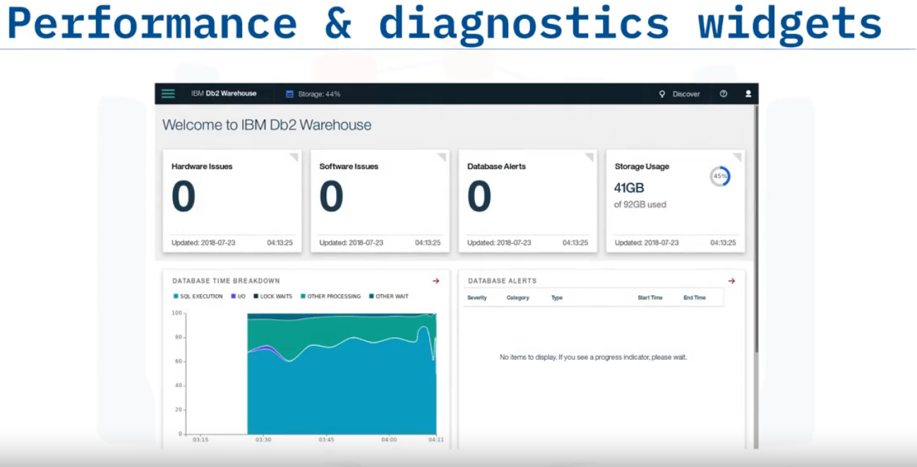
Db2 Warehouse comes with dashboards for monitoring performance and reporting issues. Some examples of included widgets are:
Hardware and software issue counts, database alerts, and the amount of allotted storage used.
You can also view a breakdown of how much time is spent in different states, such as waiting for locks and time to execute SQL queries, and a table of details regarding any database alert events.
There are many other widgets available, such as system and data server CPU utilization history, and others

Slide 17
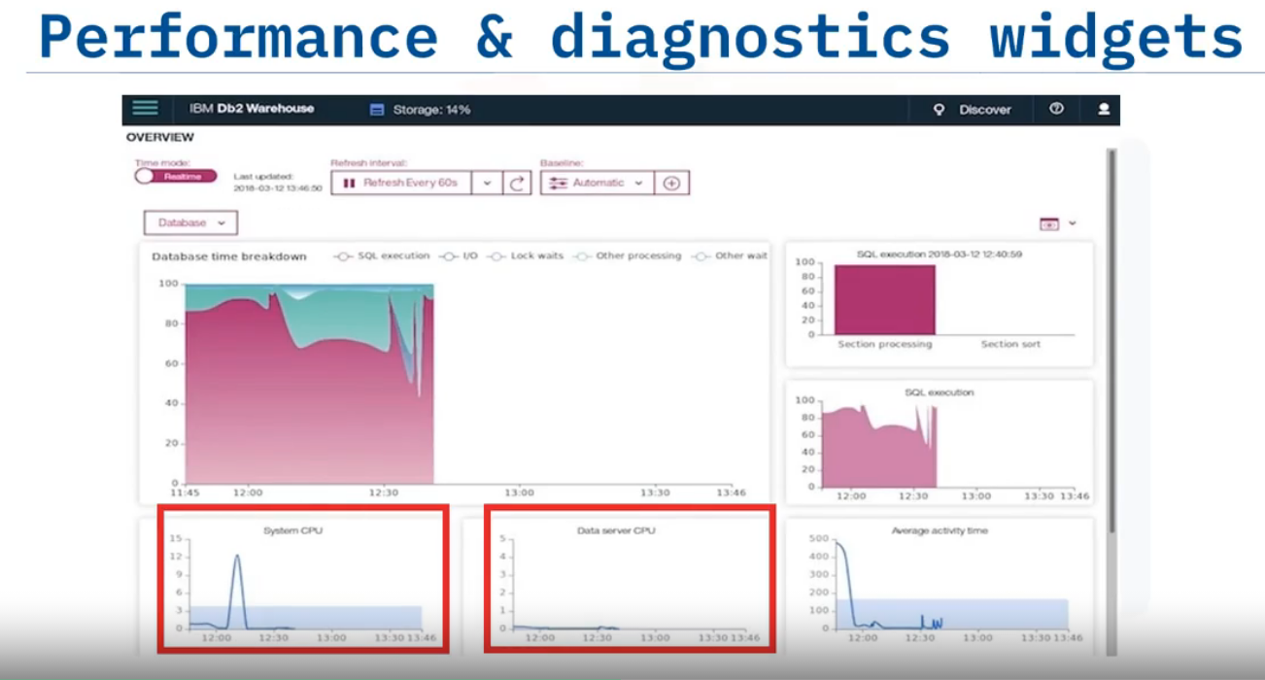

Slide 18
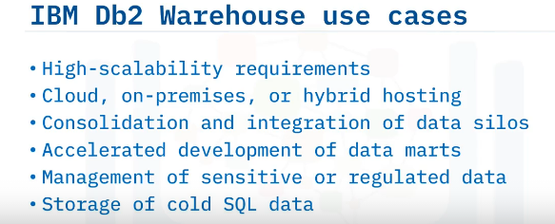
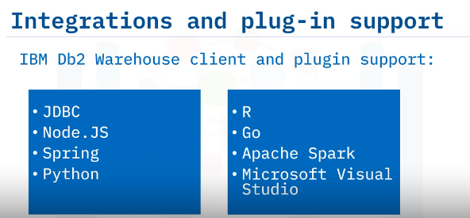
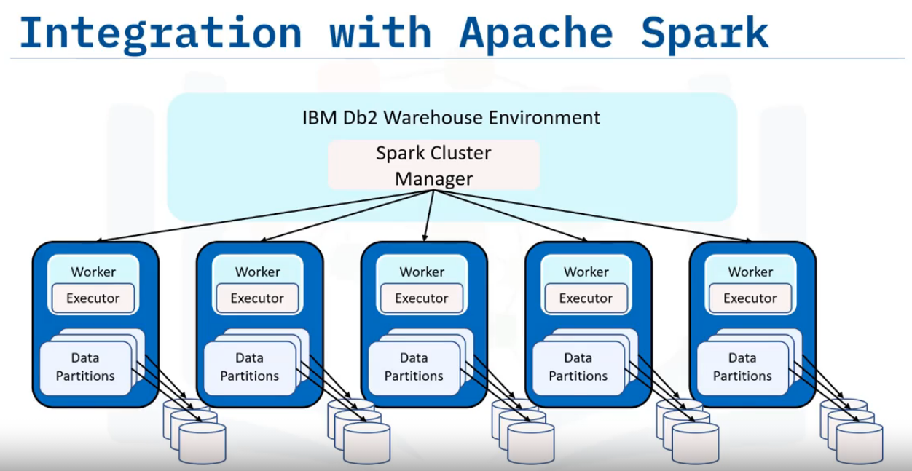
IBM Db2 Warehouse, with its integrated Apache Spark cluster, can be partitioned and deployed across a cluster of machines.
You can submit Apache Spark jobs through stored procedures to run against Db2 Warehouse, extending your analytical reach

Slide 19
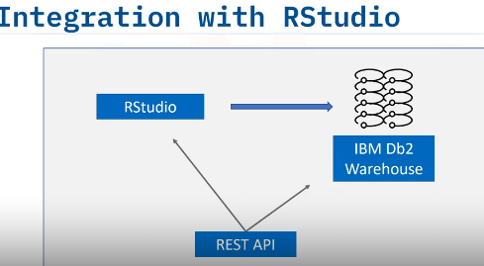
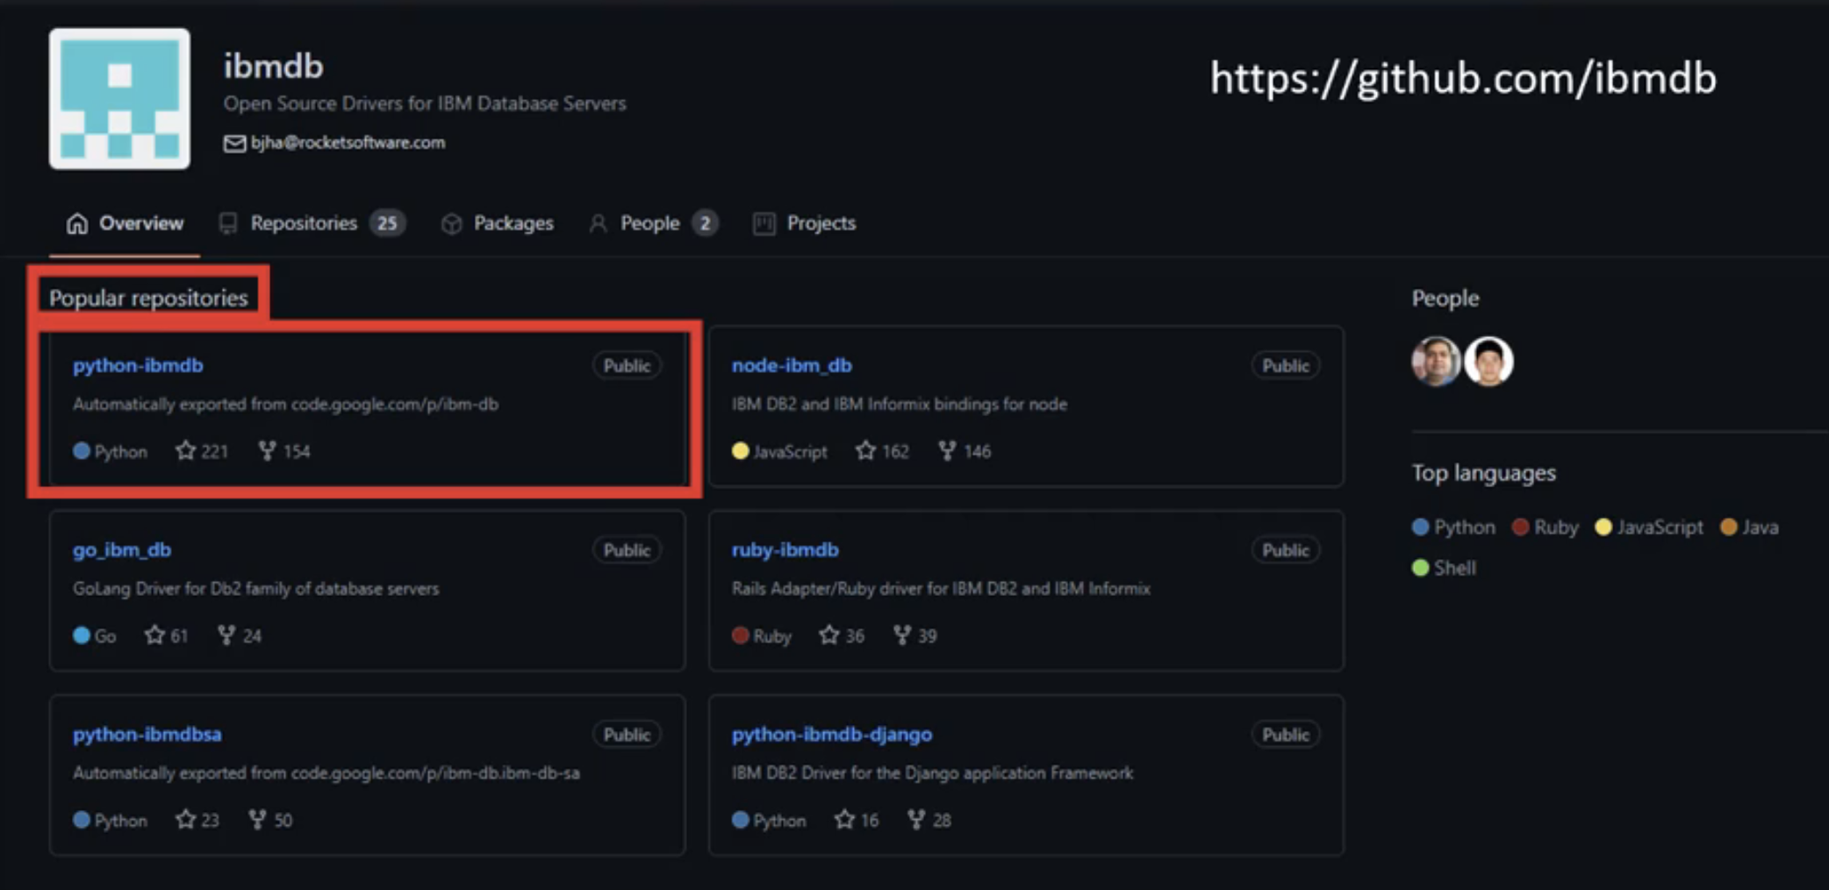
You can use R Studio to analyze, wrangle, model, and visualize your data with Db2 Warehouse.
For example, you can create your own Docker image that contains RStudio and all the packages and drivers you need to connect to Db2 Warehouse.
You can even develop applications that run R code, integrated with Db2 through a REST API.
Db2 Warehouse also has a range of commonly used open source drivers available on GitHub in the “IBM DB” repository.
For example, under “popular repositories,” you can find the “python-ibmdb” package, which provides a Python interface for connecting to IBM DB2.

Slide 20
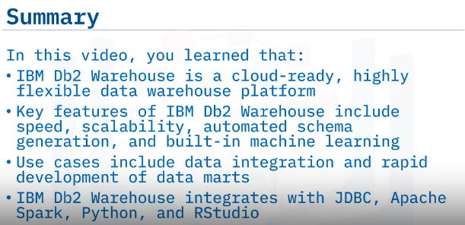

Slide 21
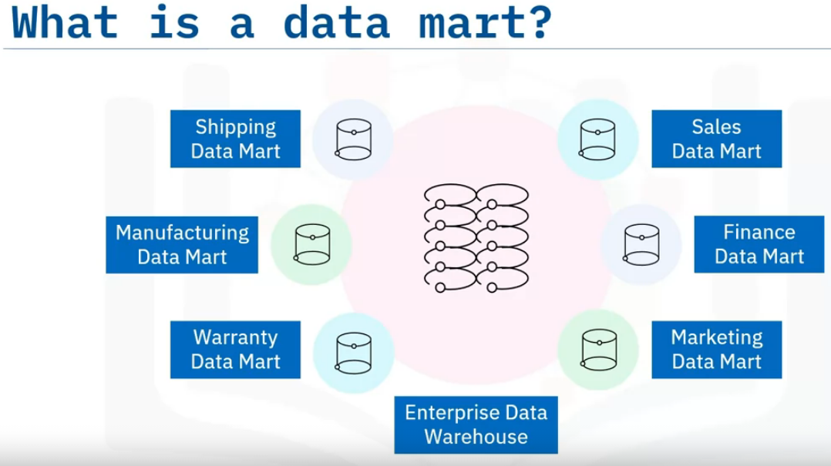
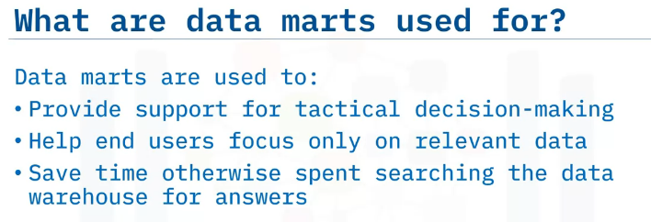
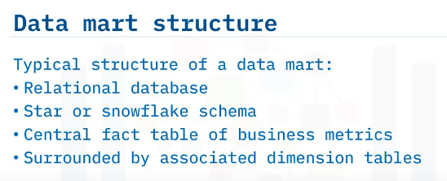
Data Mart
A data mart is an isolated part of the larger enterprise data warehouse that is specifically built to serve a particular business function, purpose, or community of users.
For example, the sales and finance departments in a company may have access to dedicated data marts that supply the data required for their quarterly sales reports and projections.
The marketing team may use data marts to analyze customer behavior data, and the shipping, manufacturing and warranty departments may have their own data marts.

Slide 22
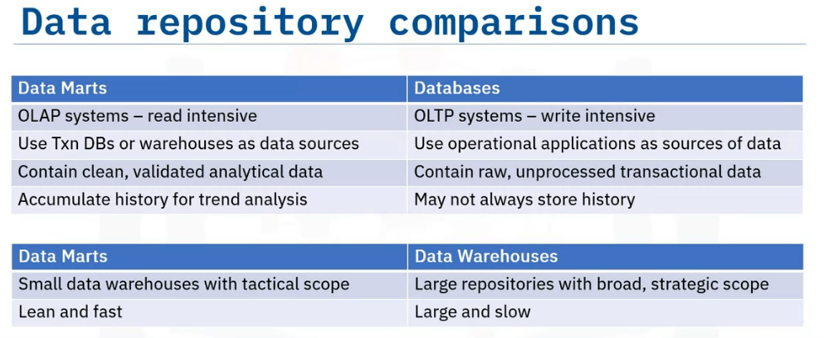
Both data marts and data warehouses are online analytical processing(or OLAP) systems that are optimized for read-intensive queries and operations, whereas transactional databases are online transaction processing (or OLTP) systems that are optimized for write-intensive queries and applications.
Data marts use transactional databases or data warehouses as data sources, while in transactional databases, operational applications, such as point-of-sales systems, serve as the sources of data.
A data mart stores validated, transformed, and cleaned data, while a database will have raw data that has not yet been cleaned.
Data marts accumulate historical data that can be used for trend analysis, while transactional databases may not always store older data.
A data mart is much like a data warehouse, except it has a smaller, tactical scope.
Data warehouses broadly support the strategic requirements of the enterprise.
Data marts are lean and fast compared to data warehouses, which can be very large, and hence, can be slower

Slide 23
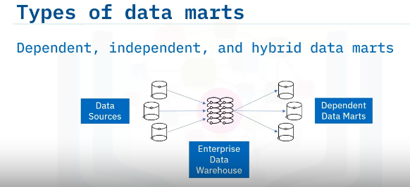
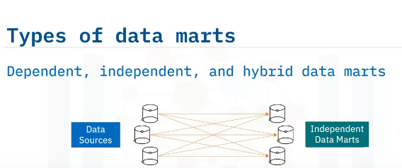
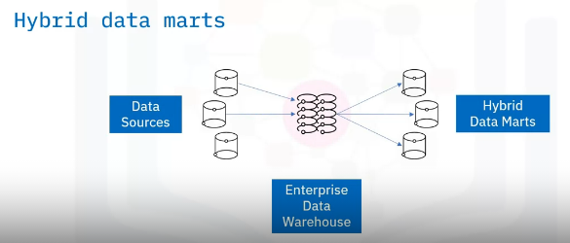
There are three basic types of data marts—dependent, independent, and hybrid.
The difference between these three kinds of data marts depends on their relationship with the data warehouse and the sources used for supplying each of them with data.
Dependent data marts draw data from the enterprise data warehouse, while independent data marts bypass the data warehouse and are created directly from sources, which may include internal operational systems or external data from vendors or other sources outside the enterprise.
Hybrid data marts only depend partially on the enterprise data warehouse.
They combine inputs from data warehouses with data from operational systems and other systems external to the warehouse

Slide 24
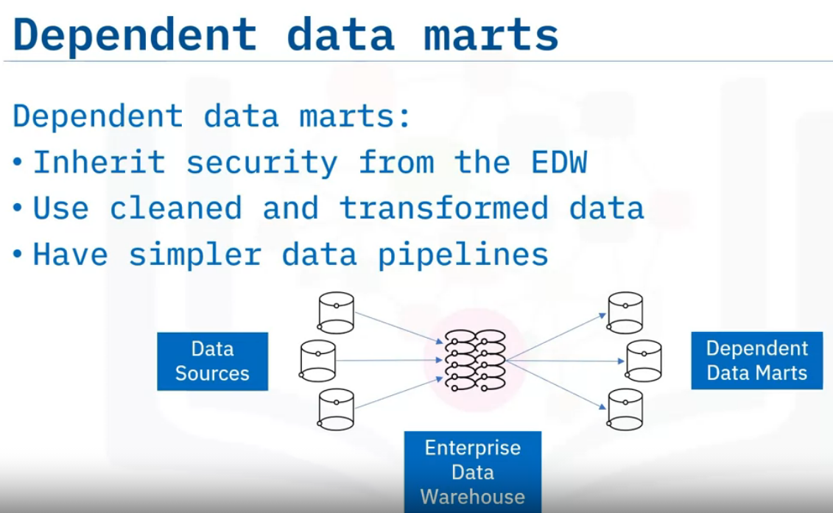
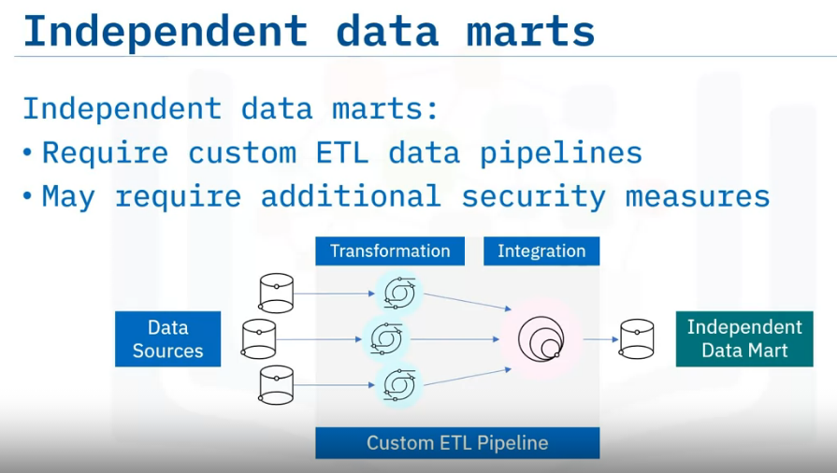
Dependent data marts offer analytical capabilities within a restricted area of the enterprise data warehouse.
Thus, they inherit the security that comes with the enterprise data warehouse.
And since dependent data marts pull data directly from the data warehouse, where data has already been cleaned and transformed, they tend to have simpler data pipelines than independent data marts.
Independent data marts differ from dependent data marts because they require custom extract, transform and load data pipelines to carry out the transformation and integration processes on the source data since it is coming directly from operational systems and external sources, and independent data marts may also require separate security measures.

Slide 25
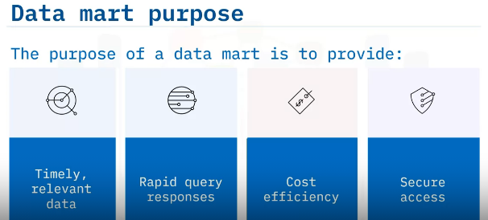
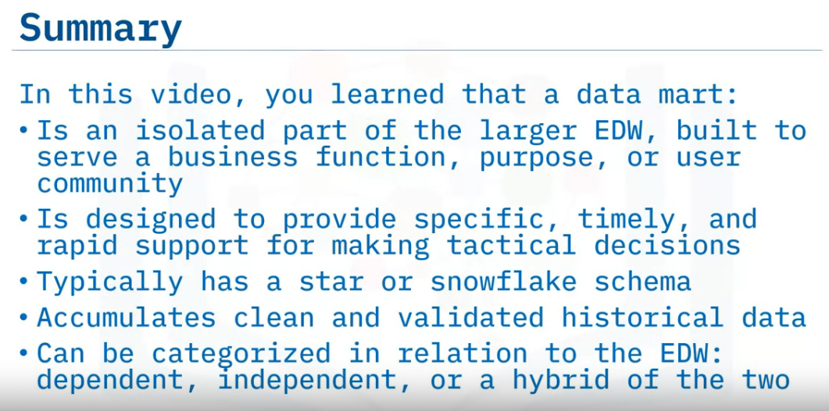
Whatever the type of data mart you may have, its purpose is to:
Provide end-users with relevant data when they need it.
Accelerate business processes by providing efficient query response times.
Provide a cost-efficient method for informing data-driven decisions, and
Ensure secure access and control over your data

Slide 26
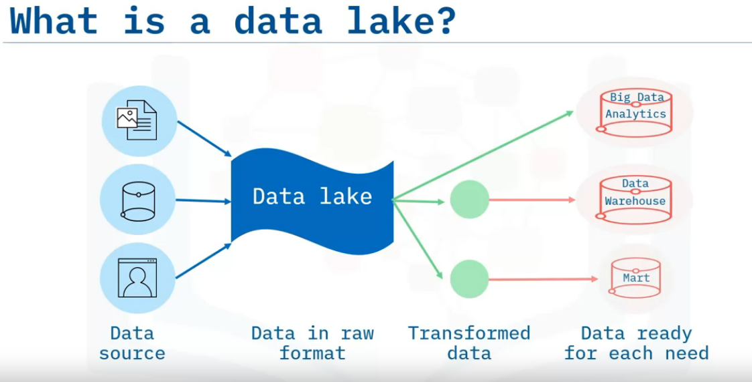
Data Lakes Overview
A data lake is a storage repository that can store large amounts of structured, semi-structured, and unstructured data in their native format, classified and tagged with metadata.
While a data warehouse stores data processed for a specific need, a data lake is a pool of raw data where each data element is given a unique identifier and is tagged with metatags for further use.
You would opt for a data lake if you generate, or have access to, large amounts of data on an ongoing basis but don’t want to be restricted to specific or pre-defined use cases.
Data lakes are sometimes also used as a staging area for transforming data prior to loading into a data warehouse or a data mart.

Slide 27


A data lake is a data repository that can store a large amount of structured, semi-structured and unstructured data in its native format.
You do not need to define the structure and schema of data before loading the data into the data lake.
You do not even need to know all the use cases for which you will be analyzing the data.
A data lake exists as a repository of raw data, straight from the source to be transformed based on the use case for which it needs to be analyzed, which does not mean that a data lake is a place where data can be dumped without governance.
A data lake is also a reference architecture that is independent of technology.
Data lakes can be deployed using cloud object storage, such as Amazon S3.
Or, large-scale distributed systems such as Apache Hadoop, used for processing Big Data.
You can deploy data lakes on relational database management systems, as well as NoSQL data repositories that can store very large amounts of data.

Slide 28


Data lakes can store all types of data including:
unstructured data, such as documents and emails
semi-structured data, such as JSON and XML files, and
structured data from relational databases.
Scalability is another data lake benefit.
Data lakes can make use of scalable storage capacity—from terabytes to petabytes of data.
By retaining data in its original format, data lakes save organizations time that would have been used to define structures, create schemas, and transform the data.
The ability to access data in its original format enables fast, flexible reuse of the data for a wide range of current and future use cases.
Some of the vendors that provide technologies, platforms, and reference architectures for data lakes include:
Amazon |Cloudera | Google | IBM | Informatica | Microsoft | Oracle | SAS |Snowflake |
Teradata | Zaloni.
data lakes were designed in response to the limitations of data warehouses.
Depending on the requirements, a typical organization will require both a data warehouse and a data lake as they serve different needs

Slide 29



Compare data lakes with data warehouses:
When it comes to data, in a data lake, data is integrated in its raw and unstructured form.
A data warehouse is different.
Here all data has already been processed and conformed to standards prior to loading to the warehouse.
when using data lakes, you do not need to define the structure and schema of the data before loading into the data lake.
A data warehouse on the other hand requires strict conformance to schema and therefore a schema needs to be designed and implemented prior to loading the data
In data lakes the data might or might not be curated,
for example raw data. And data is agile and does not necessarily comply with governance guidelines.
In comparison, the data in data warehouses is curated and adheres to data governance.

Slide 30



Slide 31
Data Lakehouse : it is a combination of Data Lake (Flexibility, cost effectiveness) and Data Warehouse (structure, performance, governance)

